Slide 1
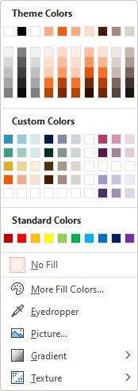
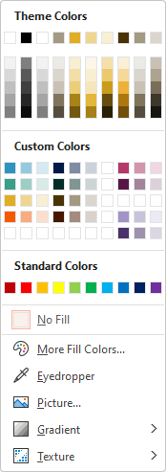
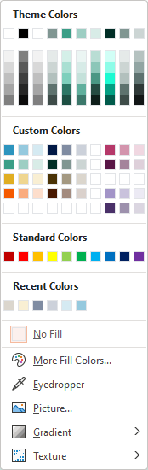
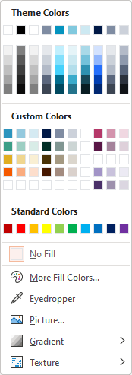
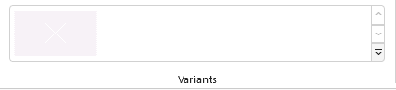
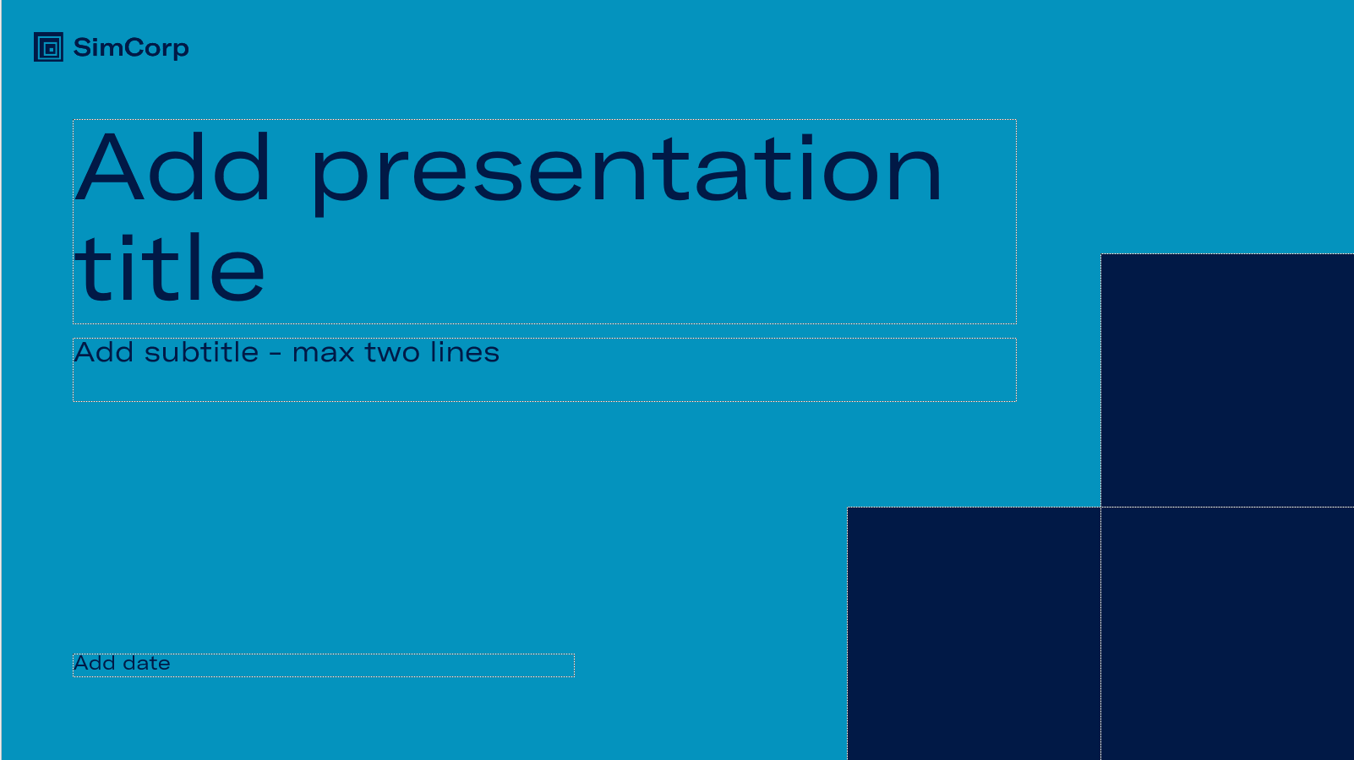
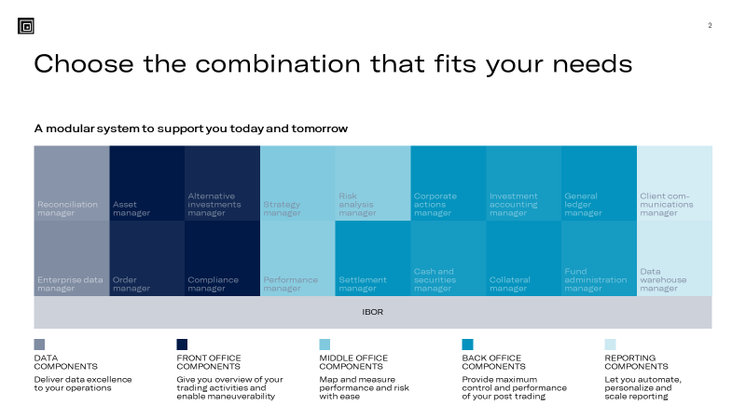
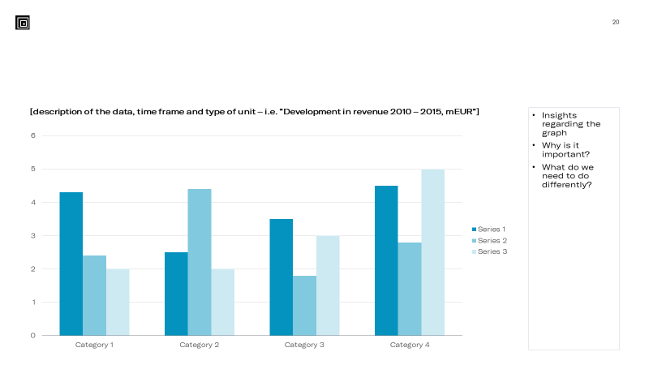
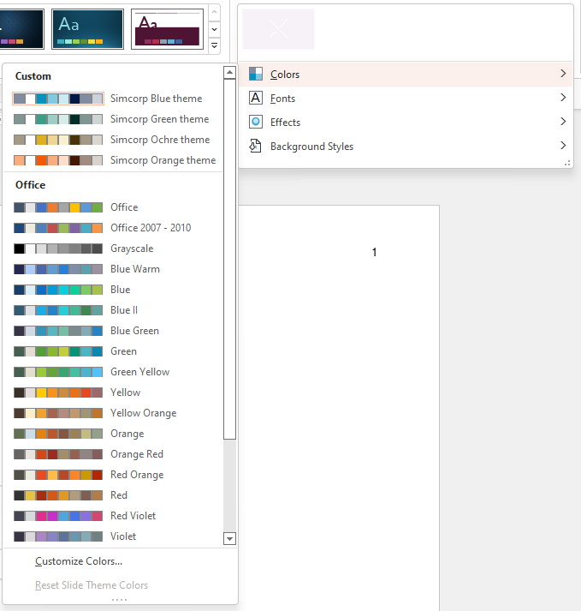
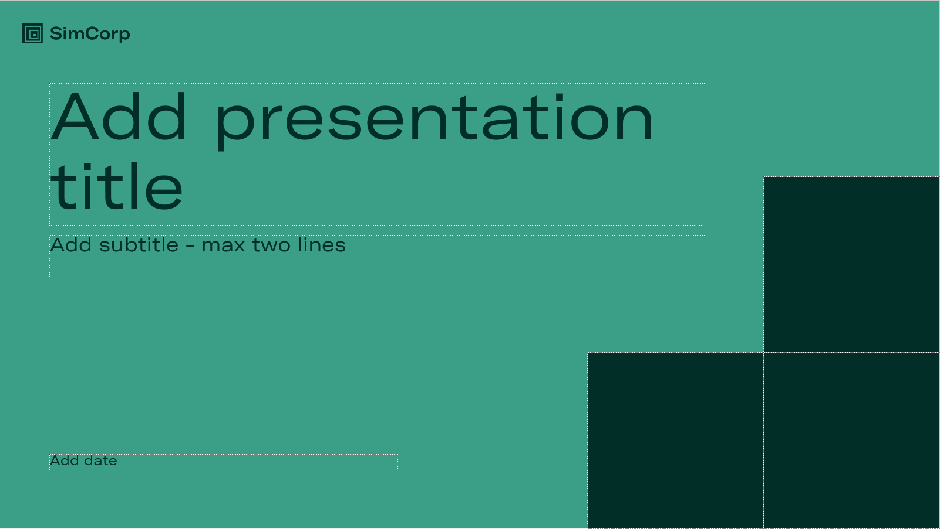
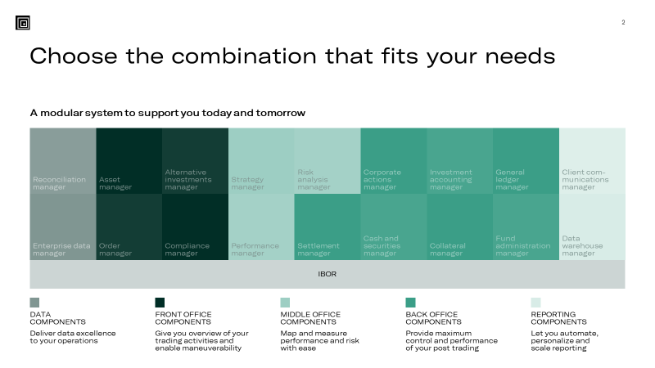
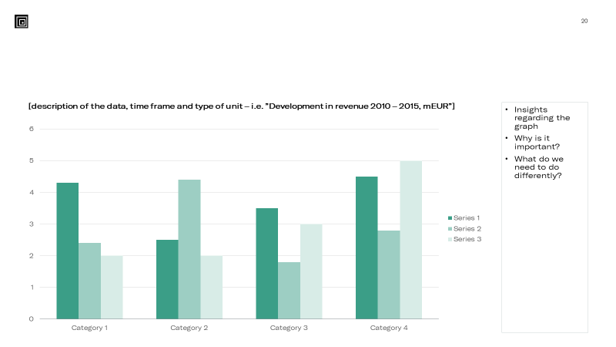
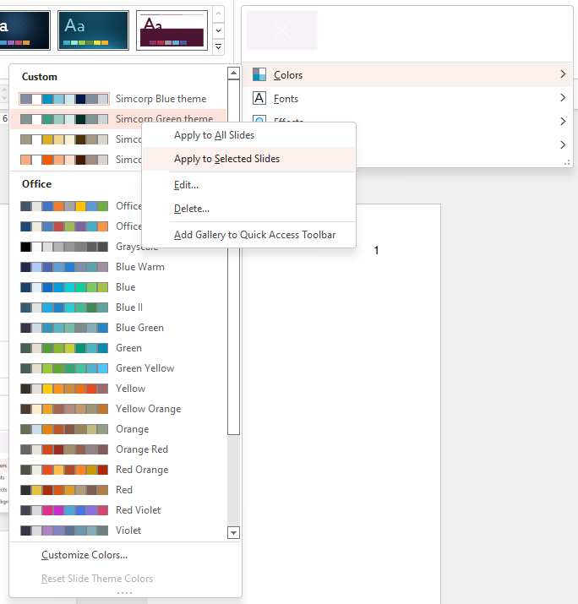
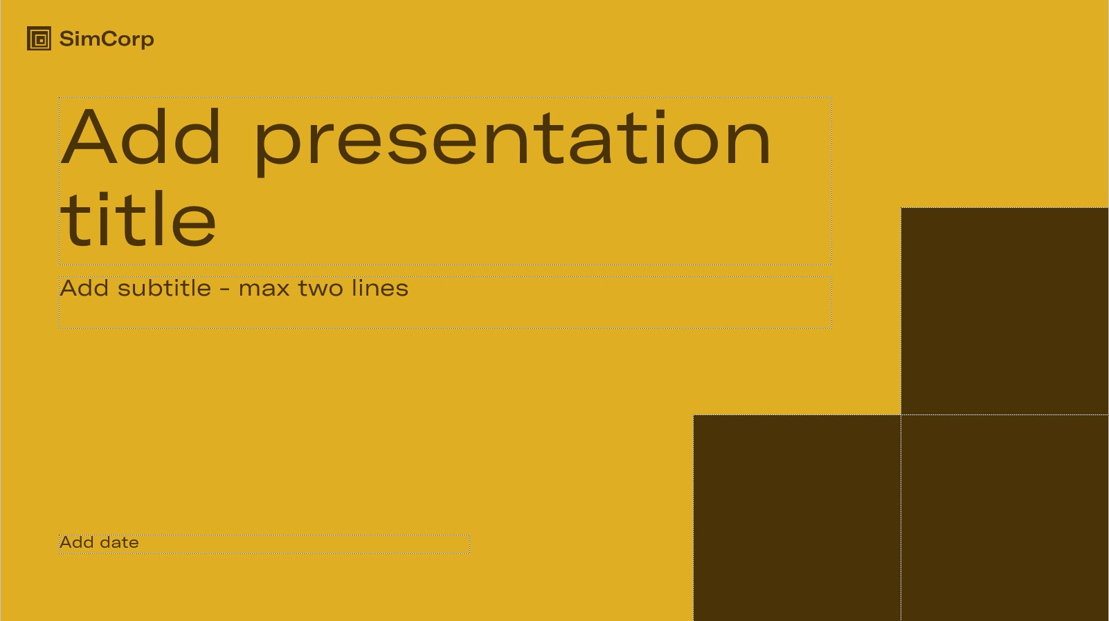
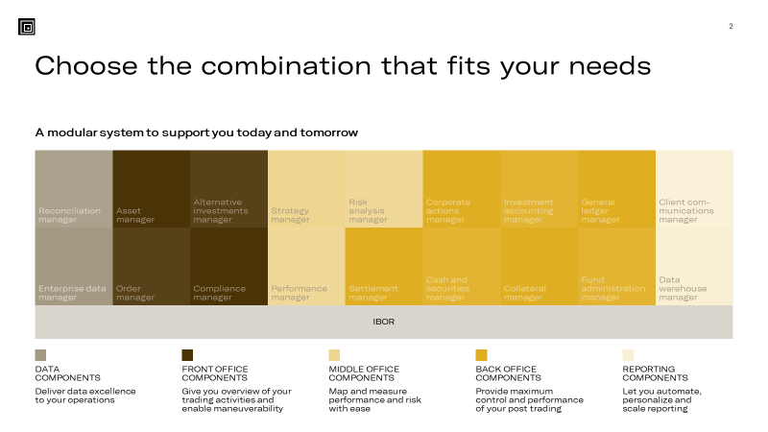
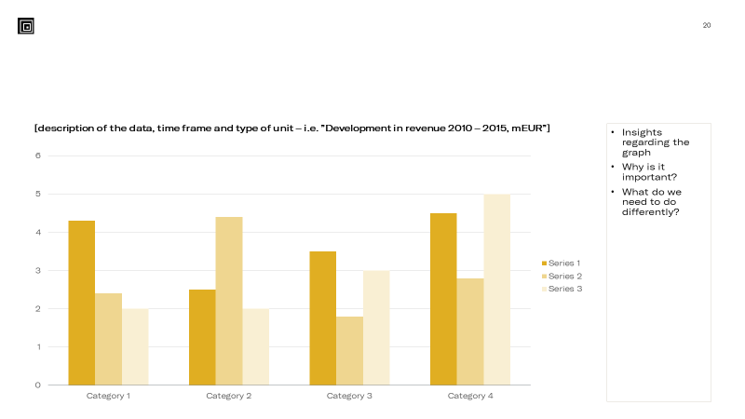

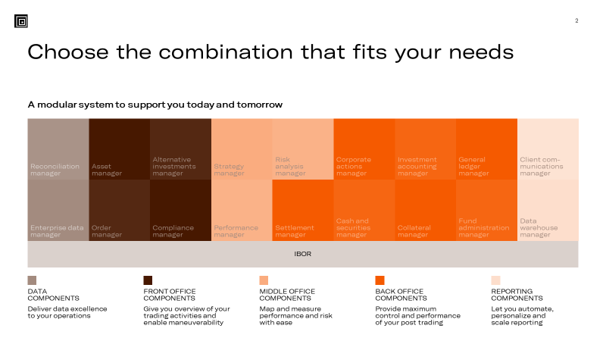
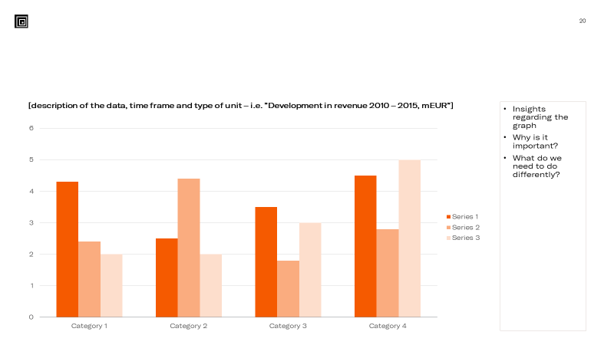
Changing the color theme for one or more slides
SimCorp has four color themes: Blue, Green, Ochre, and Orange.
How to change the color theme
Use the right colors
You can change the theme for a single slide or for selected slides.
Please do not “mix and match” the color themes at random. Instead, follow these guidelines:
Choose either one color theme for the entire presentation or a color theme for each section in the presentation
Change the color theme for a single slide to emphasize a key message in the presentation
First, select the slide(s) you want to change and then, in the Ribbon, go to the Design tab
In the Variants section, click the drop-down arrow and click the Colors section
Right-click on one of the four SimCorp color themes and select either ‘Apply to All slides’ or ‘Apply to Selected slides’
The top row of the color scheme holds the Theme Colors. These colors will change when you change the color theme.
Custom Colors holds all the SimCorp colors including the tertiary colors (Ruby and Twilight). Custom colors are ‘hardcoded’, i.e., they will not change when you change the color theme.
The 50 tints below the Theme Colors as well as the Standard Colors are not part of SimCorp’s brand colors and should not be used.
Additional colors for charts
If you need more than 6 fill colors in a chart, please do not use the additional fill colors PowerPoint suggests. Instead, utilize the SimCorp color themes by picking a Custom Color for each segment following this sequence: Blue (x6), Green (x6), Ochre (x6), and Orange (x6).

Slide 2
From I developed and tested it to I developed and my CI tested it
Automate and structure tedious but important tasks
Lars Stampe Villadsen
SimCorp A/S
Dyalog User Conference - Olhão
October 9-13th 2022

Slide 3
Me
Define SimCorp
Define Scope
Define an application
Build a unit test engine
Run a unit test engine
Automate a unit test engine
Show pull requests validation
Show merge gate (code lines, builds CPUs, costs)

Slide 4
Me
Working with APL since 1992 where I started in SimCorp - “Whenever possible ‘steal’ code”
System Architect in “Engineering Platform” responsible for the qualification pipeline for the SimCorp Dimension Solution.
“Current” challenge:
Moving SimCorp Dimension from own developed repositories (and pipelines) to GitHub based on files for all APL (and other programming languages) components – while everything still works.

Slide 5
The world’s leading provider bringing integrated solutions to investment managers
Servicing the global buy-side market
Established in 1971
Headquartered in Copenhagen, Denmark
Listed on Nasdaq Copenhagen
Offices across EMEA, North America, and APAC
2,000 employees​
Notes:
Since 1971 SimCorp has been delivering state-of-the-art investment management software for the global financial industry.
Over the past 10 years, SimCorp has demonstrated sustainable and organic growth, building a robust business by offering one, seamlessly integrated software solution to investment management firms around the world.

Slide 6
The world’s leading provider SimCorp Dimension® usage around the world
EMEA
151 clients
26% market share 570 potential clients
NORTH AMERICA
37 clients
APAC
19 clients
7% market share 550 potential clients
11% market share 180 potential clients
Note: SimCorp Dimension clients (as of end-Q4, 2021)

Slide 7
Motivation
“All” developers test their solutions
If they are seasoned (or young), they build functions that test those solutions for them
If they are "modern" they automatically run their test functions using Continuous Integration (CI).
We will demonstrate how everyone can move from the initial step to the last step using standard (free) tools for APL where the code is maintained in files.

Slide 8
Motivation
https://www.youtube.com/watch?v=HATjrrnPI5Q
Roy Osherove – Understanding Test Driven Development

Slide 9
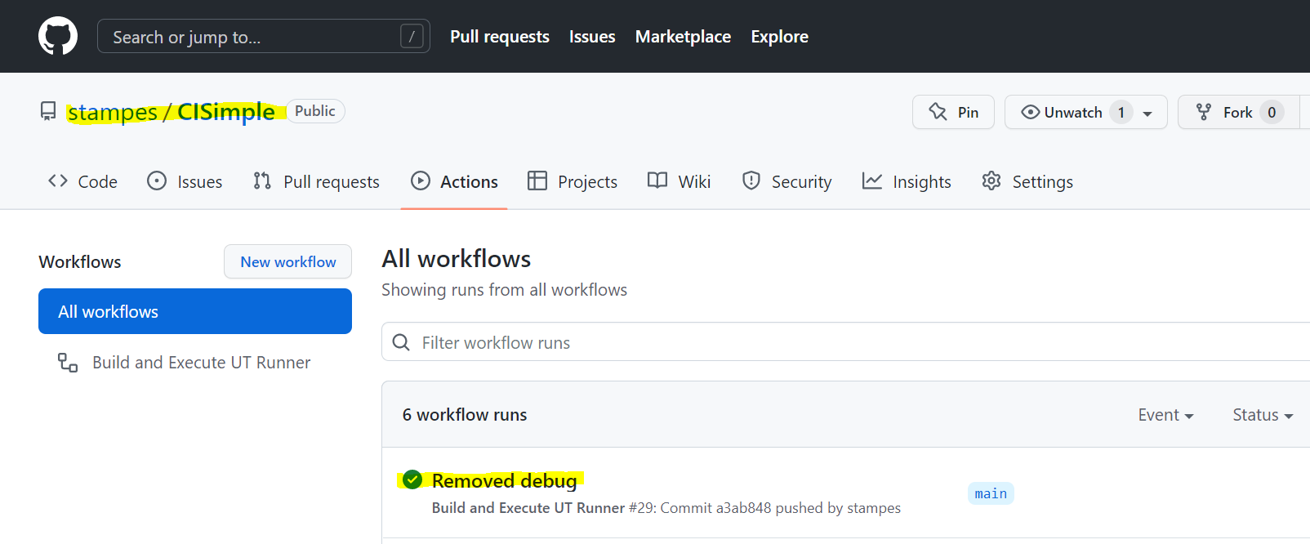
Motivation (where will we end)

Slide 10
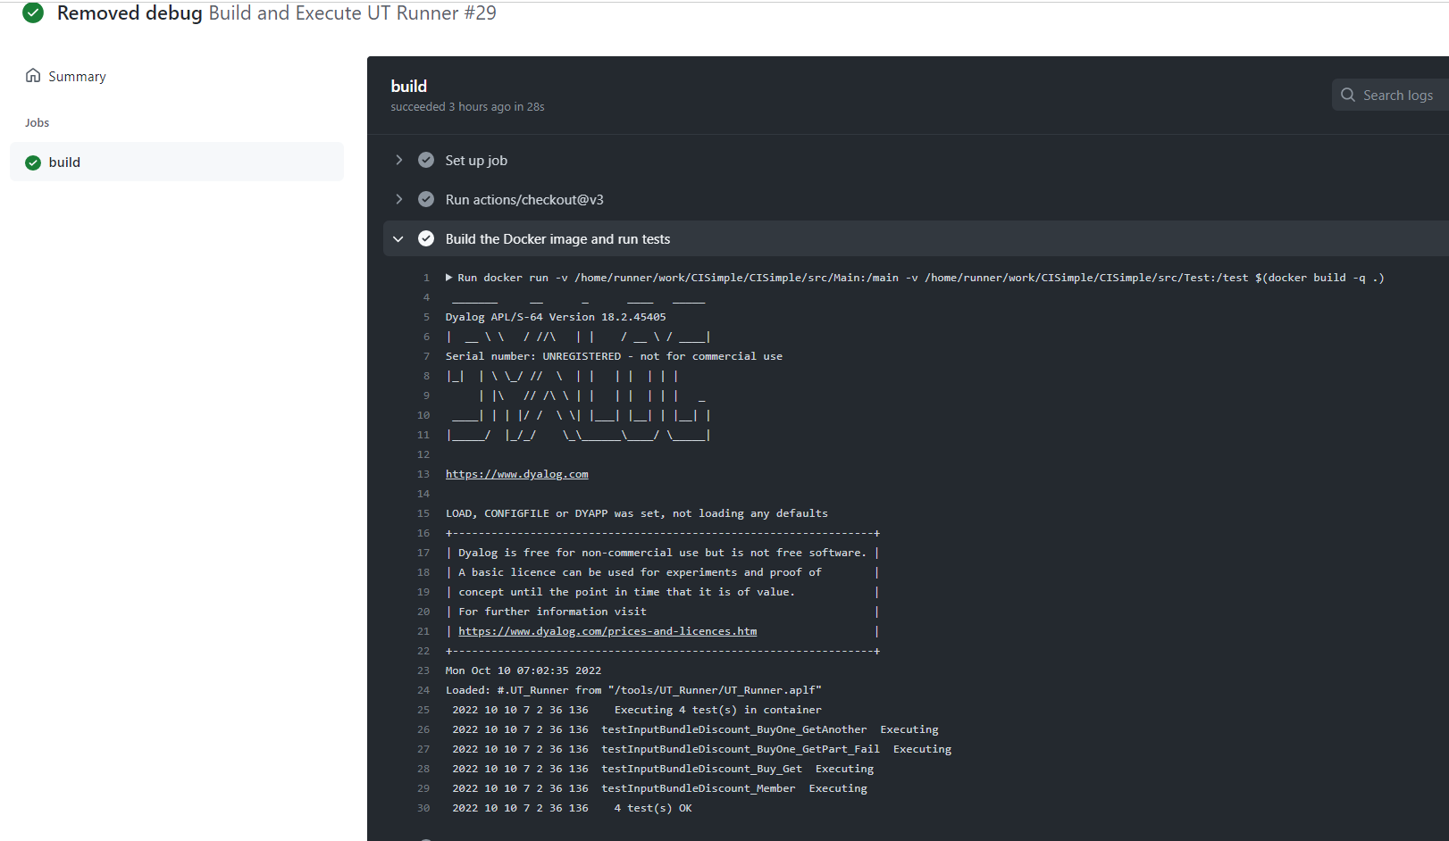
Motivation (where will we end)

Slide 11
Let us define an Application
Assumptions (you can ease these for own purpose):
All application source files are placed in a .\src\ folder (and sub-folders) – All source files are *.aplf files
No initialization of application code is needed
All test source files are placed in a .\src\ folder (and sub-folders) - All test files are *.aplt files
All test functions will be niladic and throw a signal if the fail

Slide 12
Let us make a simple application
Be able to parse and validate a set of discount statements:
Buy one, get one free
Buy two get one free
Buy shirt, get pants at 50%
Get 10% off if you're a member
Products:
Pants
Shirt
Socks
Shoes
Hat

Slide 13
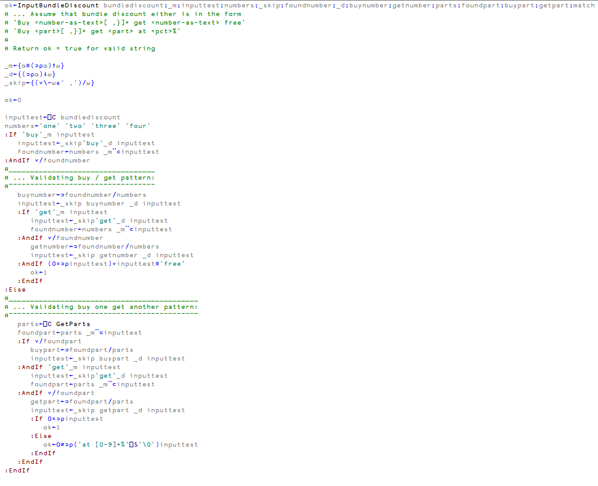
Let us make a simple application
Notes:
Show in Visual Code….
Demo that it runs:
.\Dyalog.cmd
Load application
+2 ⎕FIX¨(⊂'file://'),¨'c:\repos\CISimple\src'{⊃⎕NINFO⍠('Wildcard' 1)('Recurse' 1)⊢⍺,'/*.',⍵}'aplf’
Run:
InputBundleDiscount 'Get one get one free’
0
InputBundleDiscount 'Buy one get one free’
1

Slide 14
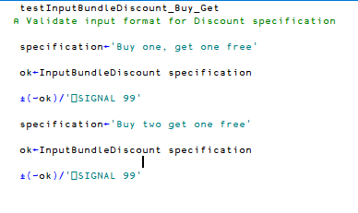
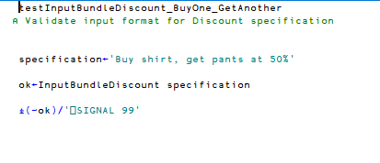
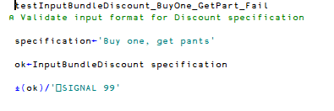
Save tests for simple application
Notes:
testInputBundleDiscount_BuyOne_GetAnother testInputBundleDiscount_BuyOne_GetPart_Fail testInputBundleDiscount_Buy_Get

Slide 15
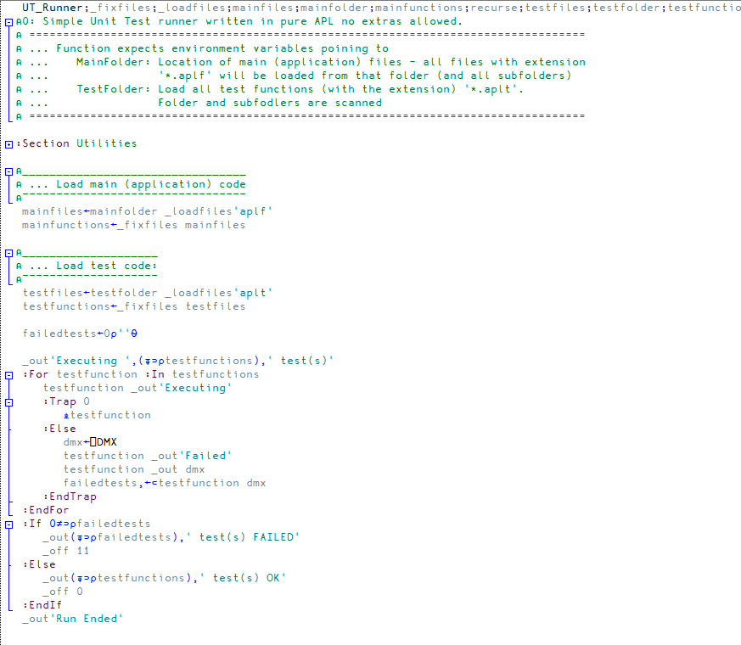
Run tests automatic in session
Notes:
Show .\Dyalog.cmd
Load runner
+2 ⎕FIX¨(⊂'file://'),¨'c:\repos\CISimple\UT_Runner'{⊃⎕NINFO⍠('Wildcard' 1)('Recurse' 1)⊢⍺,'/*.',⍵}'aplf'

Slide 16
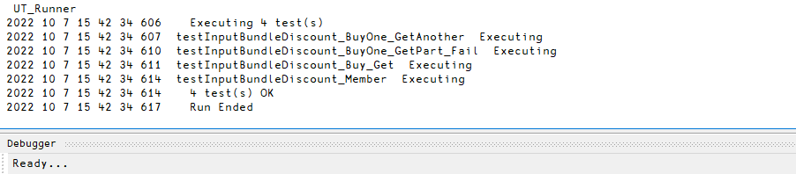
Run tests automatic in session
Notes:
Show .\Dyalog.cmd
Load runner
+2 ⎕FIX¨(⊂'file://'),¨'c:\repos\CISimple\UT_Runner'{⊃⎕NINFO⍠('Wildcard' 1)('Recurse' 1)⊢⍺,'/*.',⍵}'aplf'

Slide 17
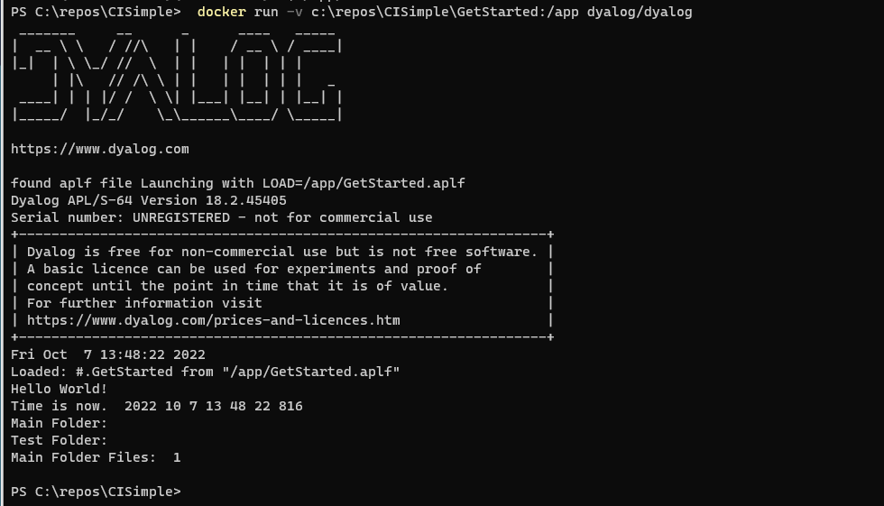
Run tests automatic w/o session
Notes:
Start Docker(!!!!!)
Run
docker run -v c:\repos\CISimple\GetStarted:/app dyalog/dyalog

Slide 18
Run tests automatic w/o session
DOCKERFILE
FROM dyalog/dyalog
USER root
RUN mkdir /main /test /tools && \
chmod 777 /main /test /tools
RUN apt-get update && apt-get install -y git
RUN git clone https://github.com/stampes/CISimple /tools
VOLUME [ "/main", "/test" ]
ENV MainFolder /main
ENV TestFolder /test
ENV LOAD /tools/UT_Runner/UT_Runner.aplf
USER dyalog
Notes:
Enhance Docker

Slide 19
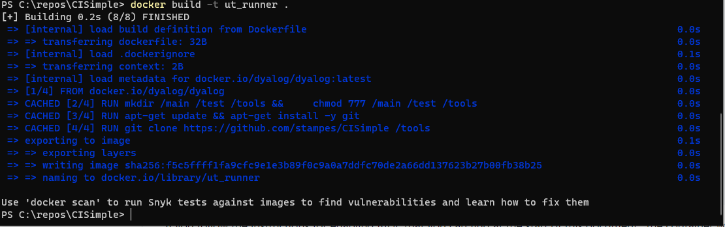
Run tests automatic w/o session
Notes:
Enhance Docker

Slide 20
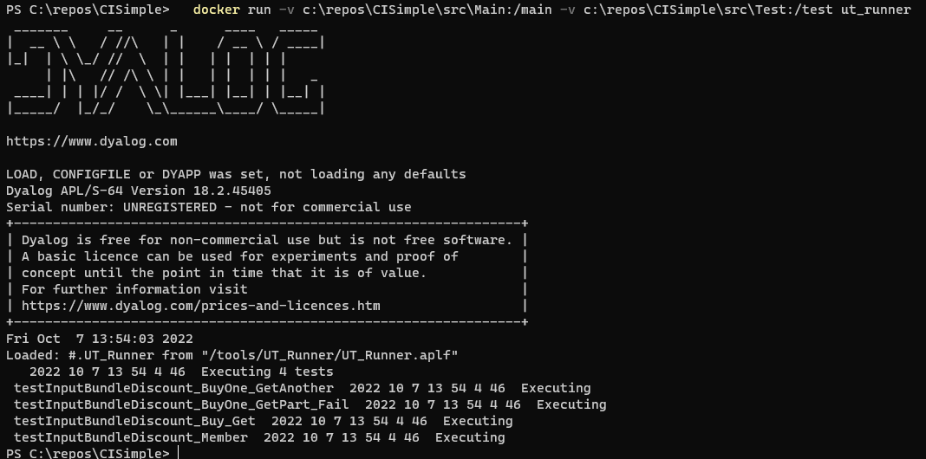
Run tests automatic w/o session
Notes:
docker run -v c:\repos\CISimple\src\Main:/main -v c:\repos\CISimple\src\Test:/test ut_runner

Slide 21
Just “Run tests”
name: Docker Image CI
on:
push:
branches: [ "main" ]
pull_request:
branches: [ "main" ]
jobs:
build:
runs-on: ubuntu-latest
steps:
- uses: actions/checkout@v3
- name: Build the Docker image and run tests
run: docker run -v ${{ github.workspace }}/src/Main:/main -v ${{ github.workspace }}/src/Test:/test $(docker build -q .)
Notes:
Save as
.github\workflows\ut-docker-image.yml

Slide 22
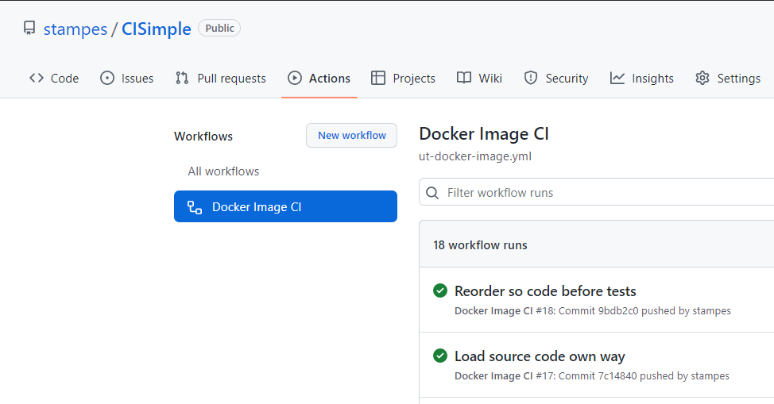
Just “Run tests”

Slide 23
Just “Run tests”
https://github.com/stampes/CISimple

Slide 24
And it just “Run tests”
Thank you

